Slide 1
INSTRUCTIONS
In the following Powerpoint, you will find a template to help you tell your story in the most impactful manner.
We designed it to make sure someone else than yourself can understand your project. Like a jury for a competition, a client for a sales call, or even a colleague who did not work on the same project.
Even though you do not realise it, you often "know too much" about your project. You are too "sophisticated" in the subject.
You've been working for years on the project, and some concepts are easy to understand for you.
But for others, it might be the first time they hear about these concepts.
Your stakeholders, most of your colleagues, and often your boss can't be a specialist in everything and might struggle to "get" what you do.
When we asked 500 professionals if they sometimes misunderstand their colleagues, and miss information - almost 98% of them answered that they do. Some even admitted that they never understand their colleagues' projects.
Using this Powerpoint template, you will respect a specific structure for the information that helps the brain of these people process the information. The template is like a formula to avoid being trapped in your own knowledge.
So for others, this means they will understand without struggling, and their attention won't drop. They will understand, get convinced, and some will even be inspired.
The four first slides of this template will help you inject the basic concepts. These are called:
1. The context
2. The real problem
3. The expectations
4. The solution as a category
You do not need to remember how the steps of the formula are called to use it. You just have to follow the formula - or the recipe - as we like to call it. As for baking a cake, if you follow the recipe, you will end up with a nice looking cake. If you don’t, it will be harder.
In slides 5 to 8, we expand on the details of what you have done in your project, add technical details, and make our reasoning more complex.
these are the steps called: 5. How it works 1 6. How it works 2 7. How it works 3
As you start to understand we are not trying to simplify the story of what you have done. We are not pretending the project was easy. We just build the understanding slide by slide, step-by-step, so a non-specialist can also understand.
We do not pretend, lie or distort the facts, but we reposition them in a logical order that makes sense to others.
One of the best ways to explain technical details in slides 5, 6 and 7, is to add a reason you have done something for each one of those slides. By writing the word “because” and explaining why you have done something, you give the listener’s brain a break.
Because of that break - his brain absorbs the information better. So use the word “because” or “so that” in each of these steps.
Finally, slides 9-10 help us inspire people.
First, by explaining your vision, the big idea you wish the world understood; and finally, by displaying your name, partners and brand.
You will find it interesting to see that the brand is at the end of this presentation.
We do not start with our name, project acronym, partners and funding reference because this is not relevant to people who don't know us yet.
The project's name and partners are relevant to you, and you would love people to remember your name and to do that, we need to convince them first.
So if your story is powerful and logical, the listener will be interested in who is "behind" the project.
To make your story logical, you have to follow the template, read the instructions, and use the examples to inspire your story.

Slide 2
INSTRUCTIONS
On each slide you will find
instructions on the top left corner, explaining you what you should ideally write.
and 4 different examples that can inspire you for your own story.
On the right side, this is where you will write your story.
We created prompts, little pieces of sentences, that will help you write faster. Decide if you want to use them or not.
PROCESS
Use the slides 4 to 13 to write, following the 10 steps of the story
Once you are done, simply delete all the instructions and examples on the left and you have your story.
Find an image that adds some visual context to what you say. If you talk about climate change, find a picture of how it affects a region similar to yours, or people you might help with your project.
You can add illustrations or icons as well, but they often provide less visual context than a real picture.
Once you are done, export to a PDF and send it to us.
Good luck, and enjoy the process.
instructions
example 1
example 2
write your story here
example 3
example 4

Slide 3
YOUR PRESENTATION
The next slides show an example and propose you to write your own sentence

Slide 4
1. context
Write in two sentences maximum where the action takes place, and in which sector we are active
Try to fit at least 2 of these 4 parameters [a date] [a location] [a number] [a topic]
In certain regions of Nigeria, having a daughter is still regarded as a burden for the family
In [this country], there is this problem [topic],and more than [xxx people] are affected
There are 1.2 billion office workers in the world, and most of them struggle to share knowledge with their colleagues and boss
Manufacturers in Europe need to constantly innovate, and adopt new materials to make their products more sustainable and comply with the legislation
For the last [xxx years], citizens living in this [region] have been struggling with [topic]
Drug Trafficking is on the rise in Europe, and represents a market of over 30 billion euros yearly.

Slide 5
2. real problem
Write in two sentences maximum the problem that the people/organisation you help have
Try to focus on one type of people/organisation [managers] [local authorities] [teachers] [developers]
For local authorities who want to help their community change, it is hard to go against hundreds of years of cultural norms
For [this people] it can be hard to [do this]
But for manufacturers, changing materials means rigorous testing, and it is hard to access the machines and skills to make this happen without stopping production
But for […] it is often problematic to fight against [this]
But for professionals with deadlines, it is hard to patiently take the time to explain every details to their colleagues and boss
But for judicial authorities, it can be difficult to fight organised crime that moves across borders constantly

Slide 6
3. expectations
Write one sentence, ideally formulated as a question, to announce what you can do for these people
A question often triggers even more attention [what if we could?] [could we..?]
Could training local authorities to have conversations with community leaders, help them start this cultural change?
Could we help [these people] do ?
What would happen if we could…?
Was there a way we could …?
Would [doing this] change the way…
Would getting access to top-tier university equipment and experienced scientists cut down on the costs to test new materials in a manufacturing process?
Could we help professionals use templates to share technical information with non-specialists?
So what would happen if law enforcement could ask each other information to plan their next operation across borders?

Slide 7
4. solution
Write one sentence, to announce the “big solution” as a category that everyone can understands.
Don’t dig into the details yet, explain the type of solution you put in place instead
We launched a workshop with role-playing debates to simulate real conversations and train civil servants
We launched a …
We created a …
We built a …
a series of workshops / a training course / an online training / a consultancy support / a prototype / a research project / a pilot project / a report / a series of events / a marketing campaign / an awareness campaign / a lobbying campaign / an investment strategy / a new process / a new material / a new standard / an infrastructure / a web app / a mobile app / a digital platform
We created a service to provide access to university laboratories, to companies who needed rapid testing
Introducing: Lyria - an AI powered website that interpret complex information and turn it into a powerpoint presentation easy to understand
We built a secured platform for police officers and judges to rapidly exchange information by text, video calls and wiki articles

Slide 8
5. how it works (1/3)
Write one paragraph max. to detail how the solution works. You have 3 slides of “How it works” - This is the first one.
Note that this slide has 2 parts - one that starts with BECAUSE. That’s because we also need an explanation to understand WHY you did something.
We started by selecting 100 civil servants who had ties with the community, like cousins, aunts and uncles, because we wanted them to understand what problems were existing, almost at a personal level
We started by [doing this…]
Because [we needed to…]
Because … so that… as a result of … and thanks to … therefore …. and so …
We started by creating a pedagogic website describing the 10 types of machines the most important to realise testing, because we needed our customers to be able to think with us about the opportunities offered by material science testing
We first gathered over 1000 project case studies and fed them to the AI, so as to train it to recognise the patterns behind the most convincing technical stories
By first conducting over 500 interviews with police officers and judges, we mapped their main communication and information needs, and thanks to that map we could start designing a solution they would use

Slide 9
6. how it works (2/3)
Write one paragraph max. to detail how the solution works. You have 3 slides of “How it works” - This is the 2nd one.
Note that this slide has 2 parts - one that starts with BECAUSE. That’s because we also need an explanation to understand WHY you did something.
We then did this because….
We then [did this…]
Because …
Because … so that… as a result of … and thanks to … therefore …. and so …
Following this, we did this so that …
As we discovered… we decided to… and thanks to that we had the possibility to…
By doing this, we manage to reach … therefore…

Slide 10
7. how it works (3/3)
Write one paragraph max. to detail how the solution works. You have 3 slides of “How it works” - This is the 3rd one.
Note that this slide has 2 parts - one that starts with BECAUSE. That’s because we also need an explanation to understand WHY you did something.
Finally, we did this [….] so that
Finally, we [did this]…
Because [we needed to…]
Because … so that… as a result of … and thanks to … therefore …. and so …
Thanks to […] we managed to… and so, …
This made it possible to […] and therefore
As we discovered, this unlocked… and as a result…

Slide 11
8. proof / credibility
Write one paragraph max. to show what you achieved in terms of performance, numbers and consider adding testimonials
You should add numbers / endorsements / testimonials, ideally one of each
In less than 12 months, we trained over 100 civil servants to lead conversations - resulting in over 1000 direct contacts with people. And we saw a direct increase of mentions in the local press of the topic - currently totalling over 200 press clips.
Since we started we…
In less than 12 months we saved … We already attracted … Our solution saves on average … We triggered … press clips The UN said of our project that … We were awarded the 2nd price for innovation We triggered 45 press mentions
In our first prototype projects we experienced a 78% decrease in the time needed to run similar experiments, and received a brilliant testimonial from the CEO of BETACOMP “we never thought we could save money and still raise the quality of our research”
Since the launch of the software in Beta version, we gathered over 2000 beta subscribers, submitting together 4000 stories; and a recent survey talked about 92% satisfaction from the beta users
In the first 6 months since launched, over 3000 police officers and judges from 18 countries have joined the platform, and contributed to over 2000 conversations. This has already lead to a common police operation.

Slide 12
9. our vision
Write one paragraph sentence a powerful vision, what you stand for, and what you want the world to be thanks to your work
Be ambitious. You deserve it.
We work everyday to fight climate change with data
this is our vision
Use your slogan
Or a quote
Or create a slogan
Think big
Thanks to that, we want to change the life of people everywhere, and make sure they never go hungry again…
By helping youngsters take confidence in their own skills, we change the Spanish job market
More than better students. Better people.

Slide 13
10. brand
Write your name, put your logos, put your partner’s logo, eventually add any information to find you - website, names of contact etc.
LOGO: Project / Organisation behind the project
this is … [name of the project]
Funded by [funder]
SLOGAN
We are ..
A team of …
working everyday to save lives with data

Slide 14
TOOLS
We built 2 tools to help you write your story even faster Attend the workshop to understand how to use them

Slide 15
Category | For | Who has the problem? | #2 Real Problem | So we created | #4 Category Solution
Training Learning | For… | professionals citizens consumers students teachers experts researchers scientists journalists doctors patients entrepreneurs managers civil servants policemen / firemen mayors | It can be hard to know how to apply this technique without support | so we created so we launched so we made available introducing… | a series of workshops
 |  |  | It can be hard to use the product without the proper training |  | a training course
 |  |  | ... might struggle to understand the concept without guidance |  | an online training
Research & Analysis |  |  | It can be difficult to make the most cost-efficient decision |  | a consultancy support
 |  |  | It can be hard to develop such product without first testing a first approach |  | a prototype
 |  |  | It can be hard to make the proper decision without first analysing what exists |  | a research project
 |  |  | ... might have a hard time adopting such solution without seeing how it works |  | a pilot project
 |  |  | It can be hard to make a decision without the right data |  | a report
Comms Marketing Convincing |  |  | It is hard to feel part of community without meeting our peers |  | a series of events
 |  |  | ... might struggle to know that the product exist without the right communication |  | a marketing campaign
 |  |  | ... might not realise that there is a service, idea, product made for them |  | an awareness campaign
 |  | Universities NGOs CSOs Research Institutes Hospitals Small companies Medium companies Large companies Governments National Authorities National Administrations Villages | It can be a struggle to know what companies on the market need and do |  | a lobbying campaign
Scale up projects |  |  | It can be hard to develop such ambition vision without the right incentive |  | an investment strategy
Innovation / New approach |  |  | ... might need a new way of doing things to save time and money |  | a new process
 |  |  | ... might require a completely new type of material to achieve such performance |  | a new material
 |  |  | It can be hard to exchange with partners when everyone does different things |  | a new standard
Physical need |  |  | ... might need a completely new ... bridge/road to unlock more trade, exchanges |  | an infrastructure
A digital tool |  |  | It can be hard to do this with traditional paper and pen (or with Excel sheets) |  | a web app
 |  |  | It can be hard to do this while seating on a computer |  | a mobile app
 |  |  | It can be hard to exchange and connect partners without the right place to meet |  | a digital platform

Slide 16
https://unsplash.com/
Unsplash is currently the most extensive free stock pictures library on the market.
You don’t need to add credits to the pictures you use, but it’s better if you do, so the creator is acknowledged

Slide 17
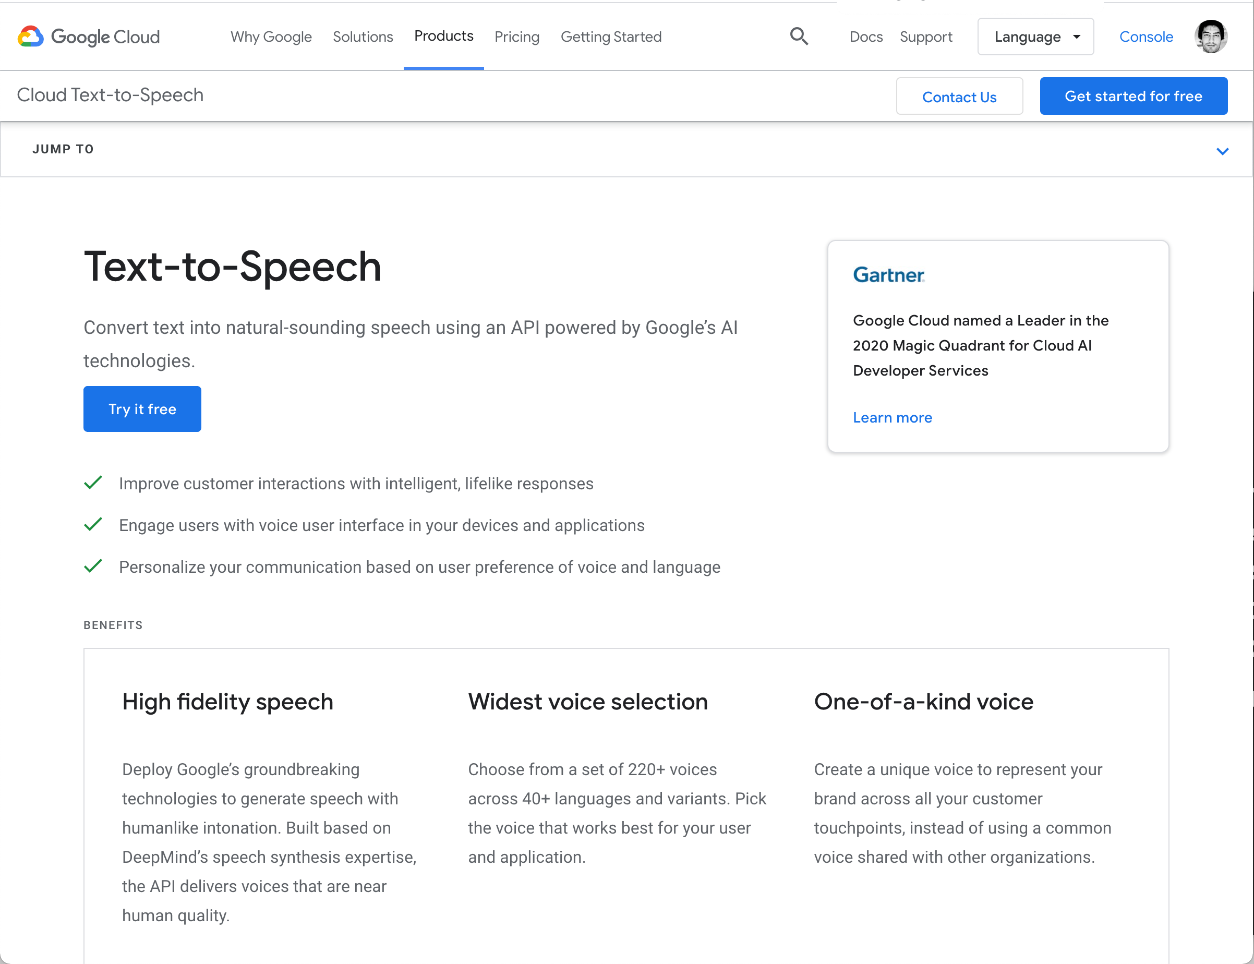
https://cloud.google.com/text-to-speech
Real-time feedback using AI voices
Testing your story is always helping you make it better.
First because you will realise that some things you know yourself, might not translate well to other people who are less knowledgeable,
and secondly because you can re-write fast, and test fast to improve your story.

Slide 18
DESIGN A SLIDE
The next slides are examples showing different layouts, using the same text

Slide 19
Technical projects often feel like a non-stop flow of information but it looks like nothing tangible is really done

Slide 20
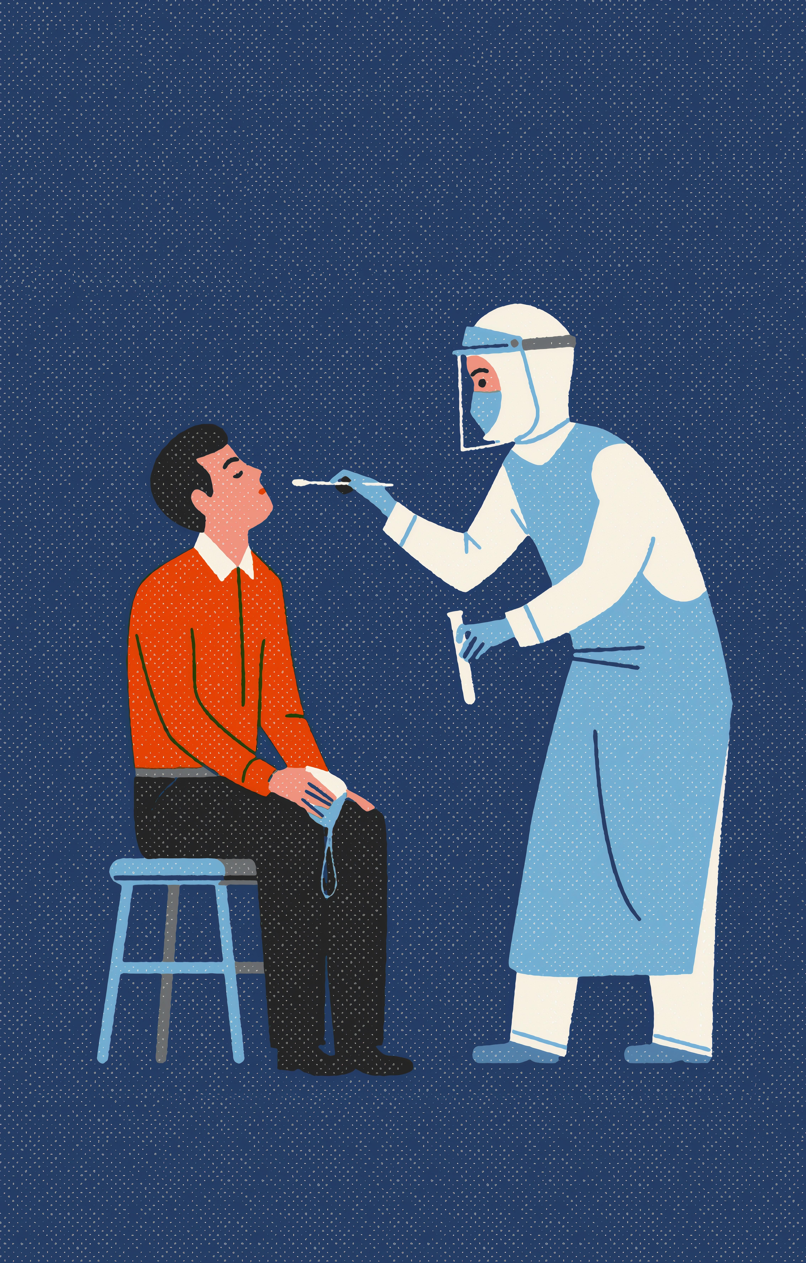
Since March 2020, almost 25% of all search on our website are related to the word COVID or Coronavirus.

Slide 21
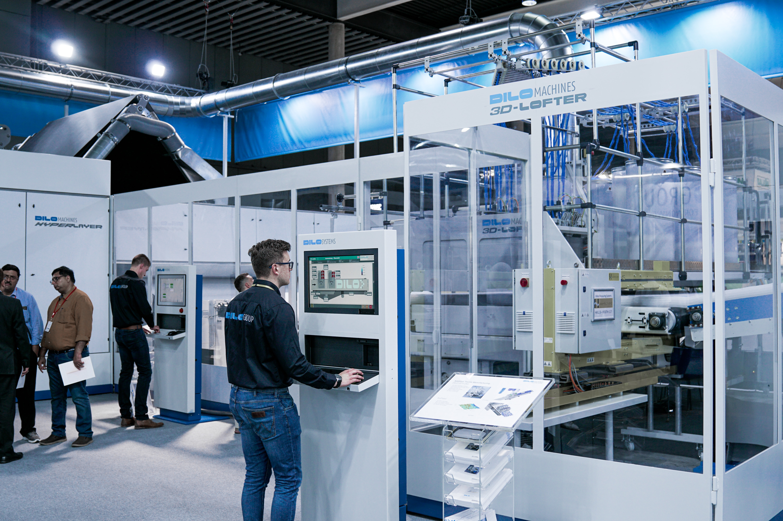
Companies working in automotive industries, need to test the composition of the new materials they create, before asking a third party to audit them.

Slide 22
Companies working in automotive industries, need to test the composition of the new materials they create, before asking a third party to audit them.

Slide 24
Since March 2020, almost 25% of all search on our website are related to the word COVID or Coronavirus.

Slide 25
We ran 10 phone interviews and a sent 50 questionnaires to businesses in the automative segment.
Our numbers
95%
positive towards the idea
1h. / week is the average time they spend looking for testing facilities
only 6 answers out of 50 raised concerns about IP (11%)

Slide 26
ICONS
If you need some icons, or some free stock images, you will find them in the slides below

Slide 27
https://unsplash.com/
Free stock pictures
Unsplash is currently the most extensive free stock pictures library on the market.
You don’t need to add credits to the pictures you use, but it’s better if you do, so the creator is acknowledged

Slide 28
https://cloud.google.com/text-to-speech
Real-time feedback using AI voices
Testing your story is always helping you make it better.
First because you will realise that some things you know yourself, might not translate well to other people who are less knowledgeable,
and secondly because you can re-write fast, and test fast to improve your story.

